Slide 1
Identification of Gait Data Using Machine Learning Technique to Categories Human Locomotion
ANUBHA PARASHAR
ASSISTANT PROFESSOR
SCHOOL OF COMPUTING AND INFORMATION TECHNOLOGY
Computer Science and Engineering
MANIPAL UNIVERSITY, JAIPUR.

Slide 2
Outline
GAIT/ Human GAIT
AIM
Proposed work and Methodology
Data Collection & Demos
Conclusion
Result analysis
Classification using KNN and Back Propagation
Problem Statement
Proposed Solution

Slide 3
What is GAIT?
Gait
Gait refers to the manner in which a person walks, and is one of the few biometric traits that can be used to recognize people at a distance.
Therefore, this trait is very appropriate in surveillance scenarios and gait recognition system.

Slide 4
Human gait
Human gait analysis refers to the study of human locomotion.
Applications are in a large variety of domains, including entertainment, healthcare, security like surveillance scenario and pedestrian navigation.
The act of walking involves the coordination of different human body parts, such as the skeleton, the muscle and the neural systems.
Various factors can affect the complex interaction between the body parts, for example any pathological nature will require a distinction between ― normal gait and pathological gait.
Normal gait refers to the general human walking parameters without differentiating the age, sex or physical parameters.
Pathological gait refers to an abnormal gait, for example affected by pathologies such as muscle weakness or skeleton deformities or due to anxiety.

Slide 5
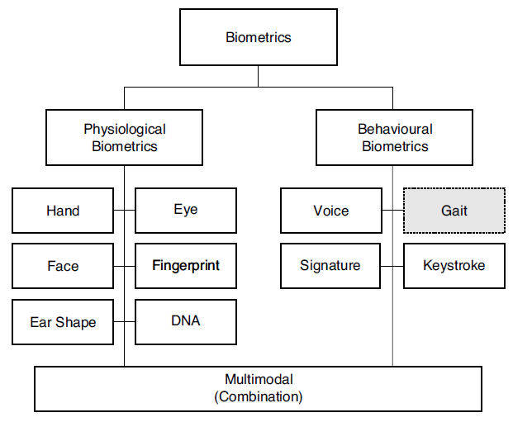
Problem Statement
To verify/validate the identity of people is called as authentication.
And now a day’s authentication is becoming very popular to check whether a person is authentic or not.
Previously authentication was done with secret passwords or PIN codes. The disadvantage of such authentication systems was anyone could crack the password or PIN codes.
So, biometric (in fig.) technology came to existence where authentication is done using a particular body part like fingers, iris etc. But now a days these biometrics are not user friendly as people dislike accessing finger print machine or avoid iris scanner as it may weaken or damage their vision.

Slide 6
Proposed Solution
Identifying normal or pathological human gait. Therefore a robust method for detecting and capturing the body, face and/or gait of each individual person has to be found.
Human gait is supposed as unique biometric identification like thumb print.
So in GAIT analysis to examine the human walking moment we collect and analyze the data.
Human gait can be utilized to identify people for diverse security reason and exercised before to detect many abnormalities.

Slide 7
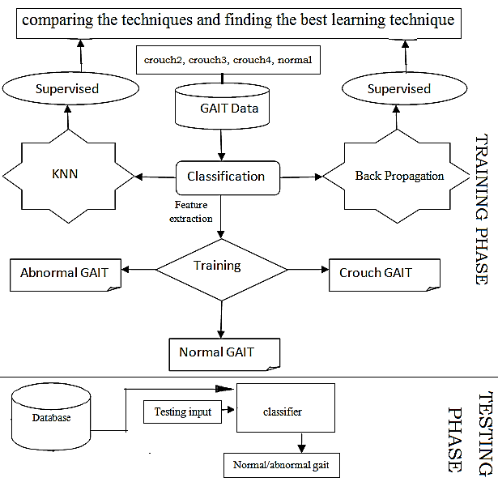
Proposed Solution

Slide 8

AIM
The aim of the paper is to evaluate and implement robust and accurate method to identify whether it’s a normal gait or pathological gait for healthcare and pedestrian navigation and for security purpose like surveillance.

Slide 9
Methodology
Friday, October 13, 2017

Slide 10
Methodology
Firstly we collect the GAIT data then features are extracted and we classify the GAIT dataset.
Training and testing of system is done.
After the Classification is done result is shown as normal or pathological GAIT.
Then 10 fold cross-validation test is also conducted to validate the statistical significance of the results.

Slide 11
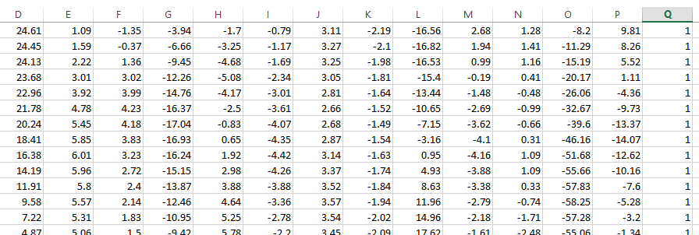
Data Collection
The data set is collected from following link
https://www.nist.gov/itl/iad/image-group/resources/biometric-special-databases-and-software

Slide 12
Analysis of dataset
When the dataset is simulated, then the coordinates of the human GAIT data set is captured and shown in figure for crouch2, crouch3, crouch4, normal datasets respectively.

Slide 13
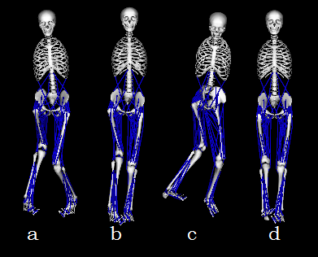
Simulation of dataset in openSim

Slide 14
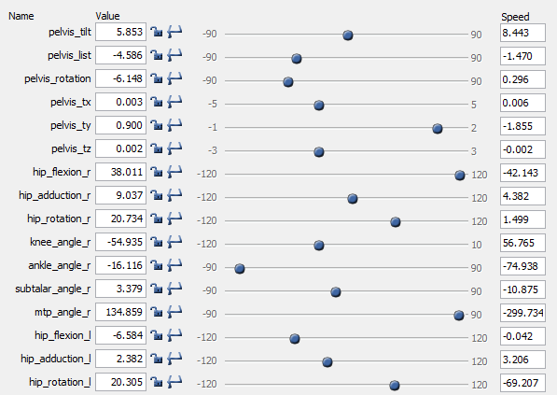
Values of crouch2 dataset

Slide 15
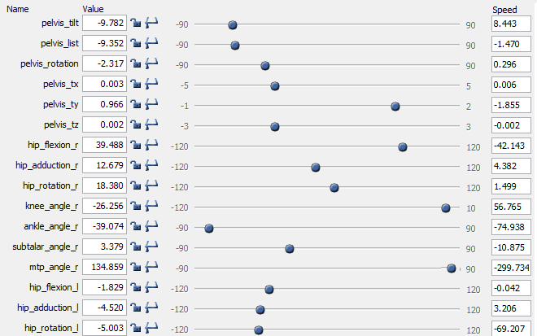
Values of crouch3 dataset

Slide 16
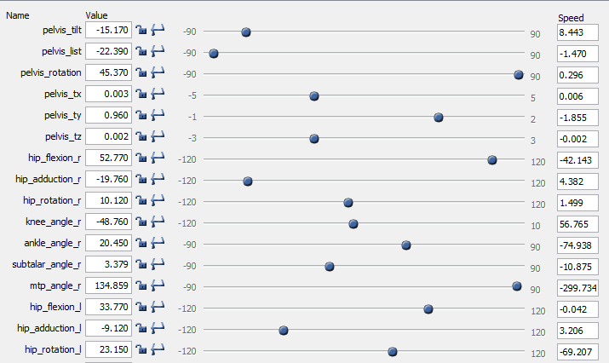
Values of crouch4 dataset

Slide 17
Values of normal dataset

Slide 18
Feature Selection
Feature Category | Feature Name
F1 | Pelvis_tilt
F2 | Pelvis_list
F3 | Pelvis_rotation
F4 | Pelvis_tx
F5 | Pelvis_ty
F6 | Pelvis_tz
F7 | hip_flexion_r
F8 | hip_adduction_r
F9 | hip_rotation_r
F10 | knee_angle_r
F11 | ankle_angle_r
F12 | ankle_angle_l
F13 | knee_angle_l
F14 | hip_flexion_l
F15 | hip_adduction_l
F16 | hip_rotation_l

Slide 19
Classification
KNN, BACK PROPOGATION

Slide 20
CLASSIFICATION
Classification is the problem of identifying to which set of categories (sub-populations) a new observation belongs, on the basis of a training set of data containing observations (or instances) whose category membership is known.

Slide 21
CLASSIFICATION TECHNIQUES USED
CLASSIFICATION of GAIT data is done using two following techniques:
KNN
BACK PROPOGATION

Slide 22
KNN
KNN can be used for both classification and regression predictive problems [1].
It is very much sensitive for outlier and noise.
It is applicable only for numerical data.

Slide 23
KNN Result
Accuracy of classification of KNN when k=1,2,3,4,5
ACCURACY | Training accuracy (%) | Test accuracy (%)
 | 100% | 87.32 %

Slide 24
BACK PROPOGATION
Backpropagation, short for "backward propagation of errors", is an algorithm for supervised learning of artificial neural networks using gradient descent [2].
Given an artificial neural network and an error function, the method calculates the gradient of the error function with respect to the neural network's weights.

Slide 25
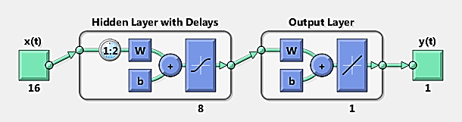
BACK PROPOGATION
In this technique we train the system with 16 input neurons in the input layer and we get 4 neurons in the output layer. For adjusting the weights of the network, training is done by back-propagation algorithm.

Slide 26
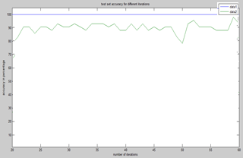
Back Propagation Result
ACCURACY | Training accuracy (%) | Test accuracy (%)
 | 100% | 94.01 %

Slide 27
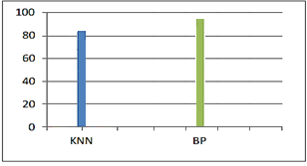
Result
ACCURACY | BACK PROPAGATION | KNN
 | 94.01% | 87.32%

Slide 28
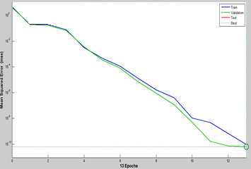
Comparison of success rate by different algorithms using 10–fold cross validation
After this, 10-fold cross validation was used to check overall accuracy of the system.
FACTORS | BACK PROPAGATION | KNN
Correlation coefficient | 0.9955 | 1.232
Mean absolute error | 8.2394 | 9.4324
Root mean squared error | 117.3938 | 132.3233
Relative absolute error | 0.741 % | 0.841%
Root relative squared error | 9.4381 % | 10.4322%
Total Number of Instances | 204 | 204
Classifier | Rate of Success (%)
KNN | 87.32 %
Back Propagation | 94.01 %

Slide 29
Classifier Fussion
Classifier Fussion | Rate of Success (%)
KNN Back Propagation | 93.82 %
Back Propagation KNN | 94.13 %

Slide 30
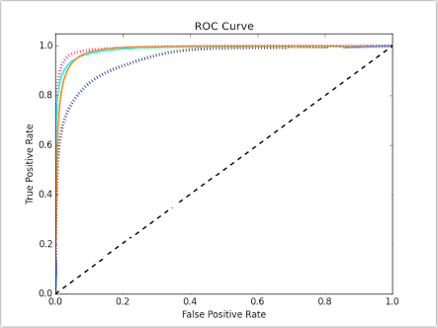
ROC CURVE

Slide 31
Conclusion
The proposed system can be used for developing a gesture controlled hexadecimal keyboard making human-computer interaction easier, surveillance scenarios for security purposes, in detecting disease of sports person and gait recognition system.
Overall accuracy was observed to be 94.01%, 87.32% using the KNN and Back Propagation.

Slide 32
References
[1]. https://en.wikipedia.org/wiki/Backpropagation
[2]. https://en.wikipedia.org/wiki/K-nearest_neighbors_algorithm

Slide 33
Questions?

Slide 34
Thank you
Have a great day ahead

